Slide 1
CSE 219: Digital Logic & Computer Design
Tamanna Haque Nipa
Assistant Professor
Dept. of CSE
Stamford University Bangladesh

Slide 2
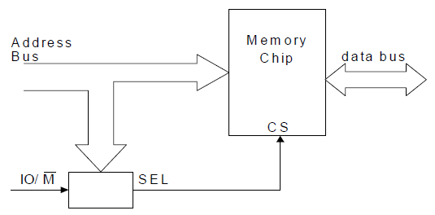
Memory Address Decoding
Address decoding refers to the way a computer system decodes the addresses on the address bus to select memory locations in one or more memory or peripheral devices.

Slide 3
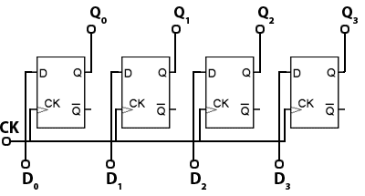
PIPO – 4 bit
IN/OUT
CLK

Slide 4
Address Decoder (4 x 8)
0
8 bit
A₁
2 x 4 line decoder
1
A₀
2
3

Slide 5
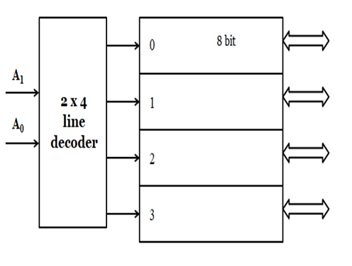
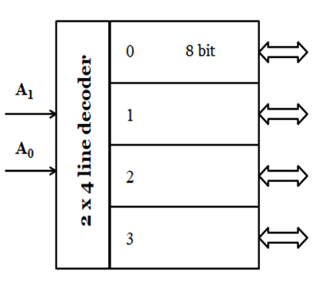
Address Decoder (4 x 8)

Slide 6
Address Decoder (4 x 8)
A₁
4 x 8 RAM / ROM
A₀

Slide 7
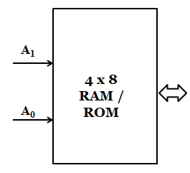
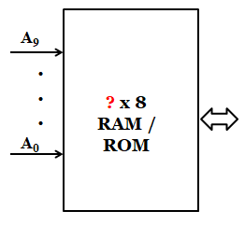
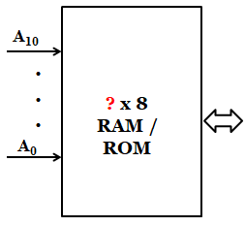
Address Decoder
Address A1 and A0 (2 bit) then addressable memory 2²= 4
Address A0 to A9 (10 bit) then addressable memory 2¹⁰ = 1024 (1 K)
Address A0 to A10 (11 bit) then addressable memory 2¹¹ = 2048 (2 K)

Slide 8
A19
A18
A17
A16
0
E1 0V +5V
RD
ROM
8kX8
3 to 8 decoder
O6
110
CS
A15
A12
A14
O3
A13
A0
RD WR
CS
RAM
1kX8
A9
Address of ROM:
A0
1st Address:
A₁₉ A₁₈ A₁₇ A₁₆ A₁₅ A₁₄ A₁₃ A₁₂ A₁₁ A₁₀ A₉ A₈ A₇ A₆ A₅ A₄ A₃ A₂ A₁ A₀
DC000
1 1 0 1
1 1 0
0 0 0 0 0 0 0 0 0 0 0 0 0
Last Address:
A₁₉ A₁₈ A₁₇ A₁₆ A₁₅ A₁₄ A₁₃ A₁₂ A₁₁ A₁₀ A₉ A₈ A₇ A₆ A₅ A₄ A₃ A₂ A₁ A₀
1 1 0 1 1 1 0 1 1 1 1 1 1 1 1 1 1 1 1 1
DDFFF

Slide 9
A19
A18
A17
A16
0
E1 0V +5V
RD
ROM
8kX8
3 to 8 decoder
O6
CS
A15
A12
A14
011
O3
A13
A0
RD WR
CS
RAM
1kX8
A9
Address of RAM:
A0
1st Address: D6000
A₁₉ A₁₈ A₁₇ A₁₆ A₁₅ A₁₄ A₁₃ A₁₂ A₁₁ A₁₀ A₉ A₈ A₇ A₆ A₅ A₄ A₃ A₂ A₁ A₀
1 1 0 1 0 1 1 0 0 0 0 0 0 0 0 0 0 0 0 0
Last Address: D63FF
A₁₉ A₁₈ A₁₇ A₁₆ A₁₅ A₁₄ A₁₃ A₁₂ A₁₁ A₁₀ A₉ A₈ A₇ A₆ A₅ A₄ A₃ A₂ A₁ A₀
1 1 0 1 0 1 1 0 0 0 1 1 1 1 1 1 1 1 1 1

Slide 10
Memory Allocation
Memory allocation is a process by which computer programs are assigned memory or space.
Types
Non-Preemptive
First Fit
Best Fit
Worst Fit
Preemptive
First In First Out (FIFO)
Least Recently Used(LRU)
Optimal(OPT)

Slide 11
Non-Preemptive-Example
There are 5 process P1 to P5. P1, P2 and P3 has been already allocated and P4 and P5 need to allocated following the 3 algorithms. Find which one is best?
0
Process | Size (kb) | Address
P1 | 150 | 0
P2 | 400 | 300
P3 | 100 | 900
P4 | 150
P5 | 200
P1 = 150 kb
149
FS1 = 150 kb
300
P2 = 400 kb
700
FS2 = 200 kb
900
P3 = 100 kb
1000
1024
FS3 = 24 kb

Slide 12
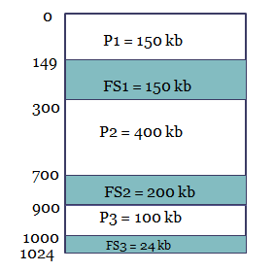
First Fit-Example
Need to fit P4=150 kb and P5= 200kb
0
P1 = 150 kb
149
Choose the first adjustable option
P4= 150 kb
300
P2 = 400 kb
700
P5 = 200 kb
900
P3 = 100 kb
1000
1024
Select FS1(150 kb) / FS2(200kb) / FS3(24kb) for P4= 150kb???
It will select FS1 then P5 will adjust with FS2

Slide 13
First Fit-Example
Need to fit P4=150 kb and P5= 200kb
0
0
P1 = 150 kb
P1 = 150 kb
149
149
Choose the first adjustable option
FS1 = 200 kb
P4= 150 kb
300
300
P2 = 400 kb
P2 = 400 kb
700
700
FS2 = 150 kb
900
900
P3 = 100 kb
P3 = 100 kb
1000
1000
1024
FS3 = 24 kb
1024
Select FS1(150 kb) / FS2(200kb) / FS3(24kb) for P4= 150kb???
It will select FS1 then P5 will adjust with FS2

Slide 14
Best Fit-Example
Need to fit P4=150 kb and P5= 200kb
0
P1 = 150 kb
149
Choose the best adjustable option
P4= 150 kb
300
P2 = 400 kb
700
P5 = 200 kb
900
P3 = 100 kb
1000
1024
Select FS1(150 kb) / FS2(200kb) / FS3(24kb) for P4= 150kb???
It will select FS1 then P5 will adjust with FS2

Slide 15
Best Fit-Example
Need to fit P4=150 kb and P5= 200kb
0
0
P1 = 150 kb
P1 = 150 kb
149
149
P5= 200 kb
Choose the best adjustable option
FS1 = 200 kb
300
300
P2 = 400 kb
P2 = 400 kb
700
700
FS2 = 150 kb
P4=150 kb
900
900
P3 = 100 kb
P3 = 100 kb
1000
1000
1024
FS3 = 24 kb
1024
Select FS1(150 kb) / FS2(200kb) / FS3(24kb) for P4= 150kb???
It will select FS2 for P4 and then P5 will adjust with FS2

Slide 16
Worst Fit-Example
Need to fit P4=150 kb and P5= 200kb
0
P1 = 150 kb
149
Choose the highest free space adjustable option
300
P2 = 400 kb
700
P4 = 150 kb
900
P3 = 100 kb
1000
1024
Select FS1(150 kb) / FS2(200kb) / FS3(24kb) for P4= 150kb???
P4 will select FS2 then P5 need to wait.

Slide 17
Preemptive Allocation-Example
Consider the following page address traces generated by CPU with 3 available frames. Find out the action generated for FIFO, LRU and OPT replacement policies. Which algorithm is best?
1, 3, 1, 4, 7, 4, 5, 3, 2, 1, 2, 1, 3, 4, 6, 7

Slide 18
FIFO
→ hit =5
1 3 1 4 7 4 5 3
*
*
1
1
1
1
7
7
7
7
3
3
3
3
3
5
5
4
4
4
4
3
2 1 2 1 3 4 6 7
*
*
*
2
2
2
2
2
2
6
6
5
1
1
1
1
1
1
7
3
3
3
3
3
4
4
4

Slide 19
LRU
→ hit =5
1 3 1 4 7 4 5 3
*
*
1
1
1
1
1
1
5
5
3
3
3
7
7
7
3
4
4
4
4
4
2 1 2 1 3 4 6 7
*
*
*
3
3
3
3
3
3
3
7
5
1
1
1
1
1
6
6
2
2
2
2
2
4
4
4

Slide 20
OPT
→ hit =6
1 3 1 4 7 4 5 3
*
*
*
1
1
1
1
7
7
5
5
3
3
3
3
3
3
3
4
4
4
4
4
2 1 2 1 3 4 6 7
*
*
*
2
2
2
2
2
4
6
7
3
3
3
3
3
3
3
3
4
1
1
1
1
1
1
1

